Slide 1



FINAL PROJECT
ROBOTICS COURSE
LINE
FOLLOWING
ROBOT
Smart Detection
and Automatic
Path Following
Presented By
Ibraim Aidana
Maratova Aisulu
Aimyrzakyzy Shugyla

Slide 2
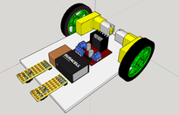

ROBOT PROJECT
INTRODUCTION
The Development of Line Following Robots
Sensors detect black and white surfaces
ESP32 processes sensor data
Motor driver controls the motors
Robot adjusts speed and direction automatically
Keeps the robot on the track continuously
Uses sensors to detect and follow a path
Moves automatically using motor control
Used in robotics and industrial automation
Applied in smart transportation systems

Slide 3
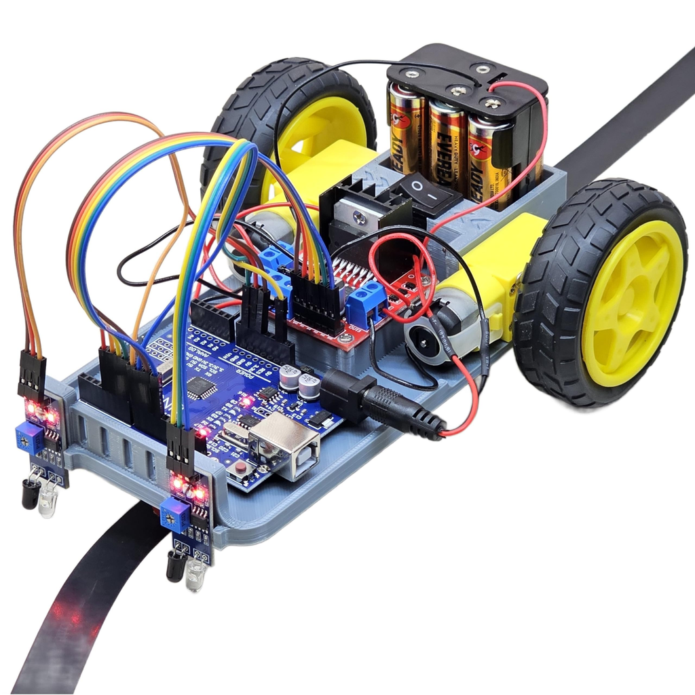
ROBOT PROJECT
PROJECT
GOAL AND TASK
Autonomous robot for line detection and path tracking using ESP32.
Design of an autonomous line following robot
Uses ESP32 microcontroller
Detects and follows a black path
Controls motors automatically using sensor data
Works without human interaction
Demonstrates robotics and embedded systems principles

Slide 4
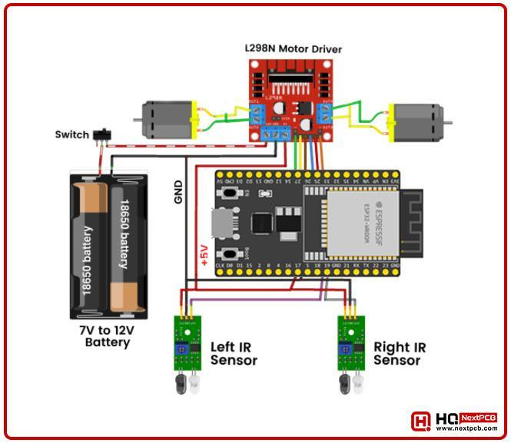
Component | Purpose
ESP32 | Serves as the main microcontroller and central processing unit of the robot
ZK-5AD Motor Driver | Used to control the direction and speed of the DC motors.
Amperka Octoliner Sensor | Multi-channel infrared sensor array used for precise line detection.
Expansion Board | The robot uses DC motors for movement, connected to wheels for mobility.
DC Motors with Wheels | The robot uses DC motors for movement, connected to wheels for mobility.
Battery | Power supply.
ROBOT PROJECT
COMPONENTS USED
HARDWARE COMPONENTS

Slide 5
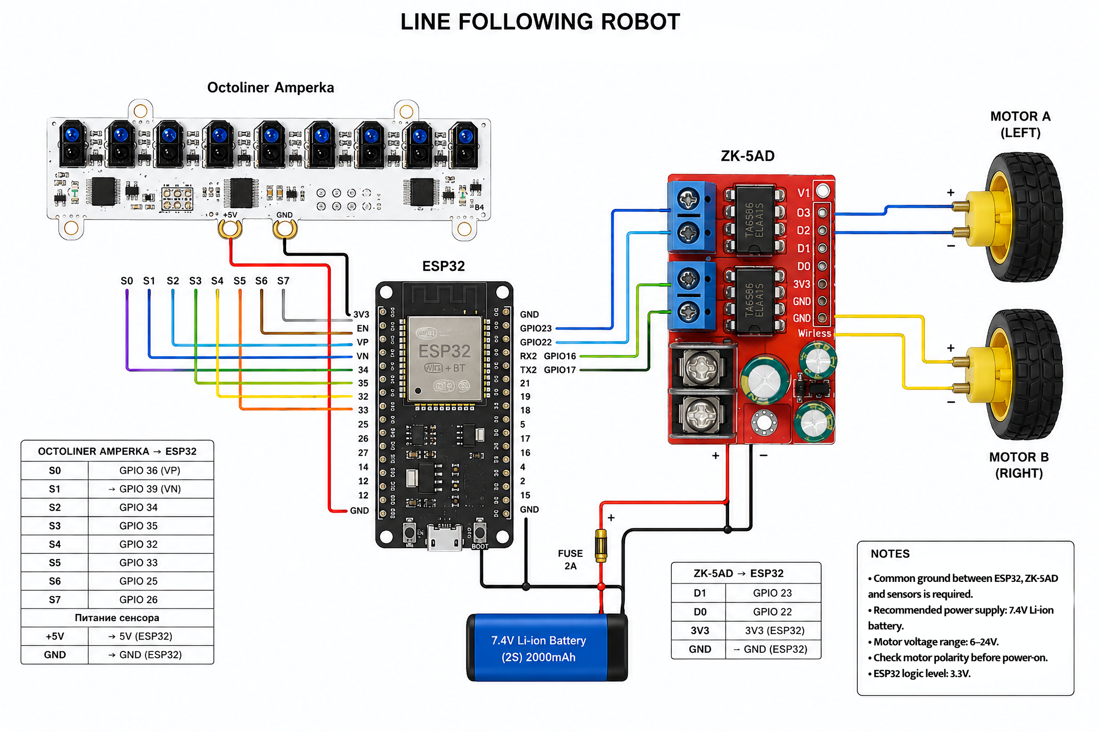

Slide 6
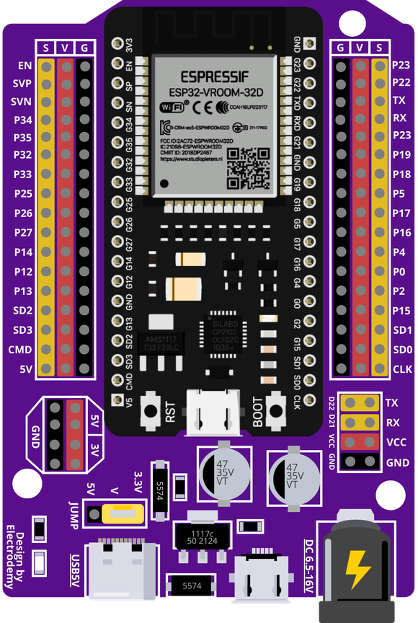

ESP32 controls the sensors and motors of the robot.
ROBOT PROJECT
ESP32 MICROCONTROLLER
IThe ESP32 is the main microcontroller used in this project. It processes data received from the Octoliner sensor and sends control signals to the ZK-5AD motor driver. The ESP32 was chosen because of its high performance, low power consumption, and built-in wireless capabilities. It serves as the central control unit of the entire robotic system.
Main controller of the robot
Processes sensor data
Controls motor driver
Fast and efficient performance
Programmed using Arduino IDE

Slide 7
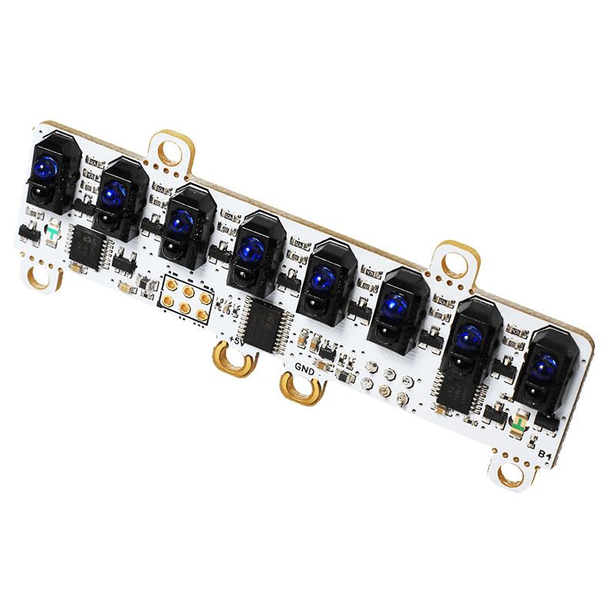
ROBOT PROJECT
Amperka Octoliner sensor for accurate line detection and path tracking.
In this project, we used the Amperka Octoliner sensor to detect the black line on the track. The sensor contains multiple infrared detectors that identify the difference between black and white surfaces. The Octoliner continuously sends sensor data to the ESP32 microcontroller, allowing the robot to determine its position relative to the line and adjust movement automatically.
Infrared line detection
Multiple sensor channels
Real-time data transmission
Connected to ESP32
Used for autonomous navigation
OCTOLINER SENSOR
CONNECTION

Slide 8
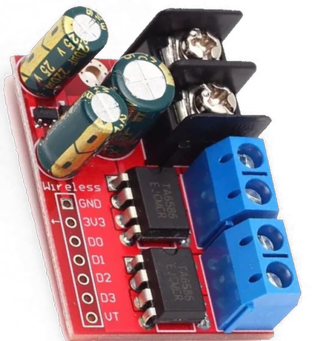
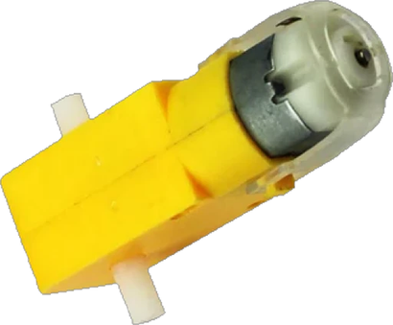

ROBOT PROJECT
Motor Driver Connection
MOTOR DRIVER AND MOTORS
ZK-5AD Motor Driver
IIn this project, we used the ZK-5AD motor driver to control the movement of the robot. The motor driver receives signals from the ESP32 microcontroller and controls the direction and speed of the DC motors. It acts as an interface between the controller and the motors, providing stable power distribution and efficient motor operation during movement.
The ZK-5AD driver allows the robot to move forward, turn left, and turn right according to the sensor data received from the Octoliner module.
Dual motor control
Receives commands from ESP32
Controls motor direction
Controls motor speed
Powered by external battery
Used for autonomous robot movement
DC motors

Slide 9
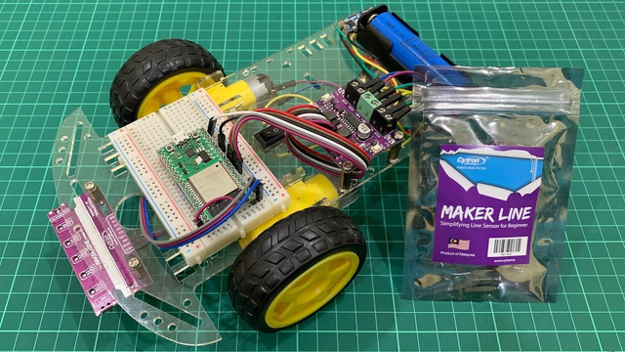

ROBOT PROJECT
The robot software continuously reads sensor values and analyzes line position in real time. Based on the detected position, the program adjusts motor speed and direction to keep the robot aligned with the track during movement.
Robot Working Algorithm
Read sensor values
Detect line position
Compare left and right sensors
SOFTWARE ALGORITHM
Adjust motor speed
Continue movement

Slide 10
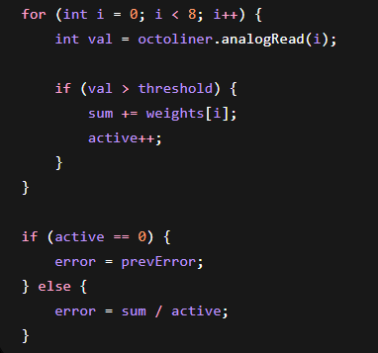

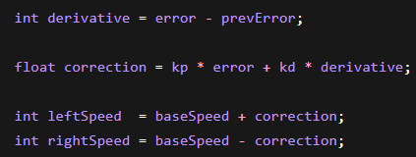
Sensor Reading and Error Calculation
ROBOT PROJECT
PROGRAMMING AND LOGIC
PD Control and Motor Adjustment
The sensor values are converted into an error value representing the robot’s position relative to the line.
The ESP32 processes sensor data and controls robot movement automatically.
ESP32 programmed in Arduino IDE
Sensor values processed in loop()
PWM used for motor speed
Conditions used for turning
PID algorithm used for line correction and stable movement
The PD controller calculates the correction value and changes motor speeds to keep the robot centered on the line.

Slide 11
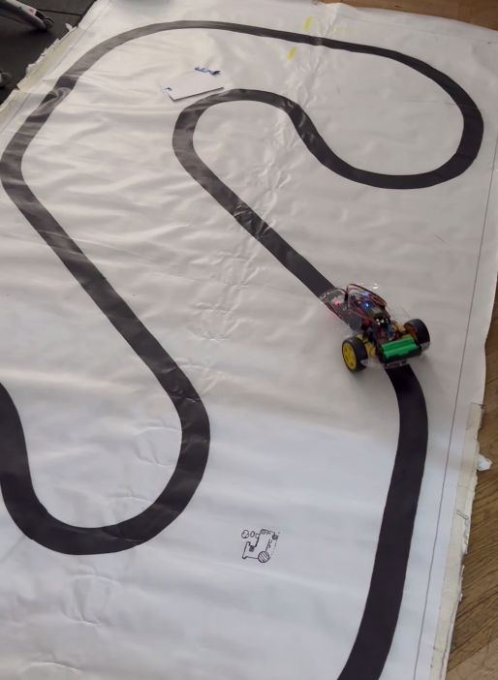
ROBOT PROJECT
CONCLUSION
Results and Testing
During testing, the robot successfully followed the predefined path and responded correctly to turns and curves. The system demonstrated stable movement and reliable sensor detection under normal operating conditions.
Robot follows black line
Detects turns
Adjusts direction automatically
Stable movement

